Slide 1
词向量及其应用
史晓东

Slide 2
提纲
什么是词向量
词向量的计算
  Word2vec
  Glove
  上下文相关词向量:ELMO/BERT
  跨语言、跨模态词向量
词向量的应用

Slide 3
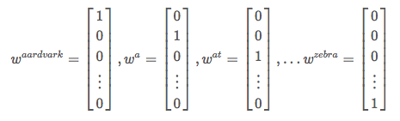
什么是词向量
传统的NLP把词看作离散的符号。One-hot向量看起来是向量，实际上也是离散的

Slide 4
什么是词向量
这样表示的问题:
  任何两个单词之间语义无关（cosine相似度为0）
  维数灾难
  与人类的语义表示相差甚远！

Slide 5
语义在大脑的表示
一个神经元表示一个概念?
  要是这个神经元死了，那被表示的概念就丢失了？
  要是一个概念用多个神经元表示，而一个神经元也可以表示多个概念，这样就不会那么脆弱：这称为概念表示的分布式假设

Slide 6
词向量word embedding
不是one-hot. 语义分布在多个维度，方便地表示不同概念间的关联
  [0.792, −0.177, −0.107, 0.109, 0.542, ...]
低维：高效处理

Slide 7
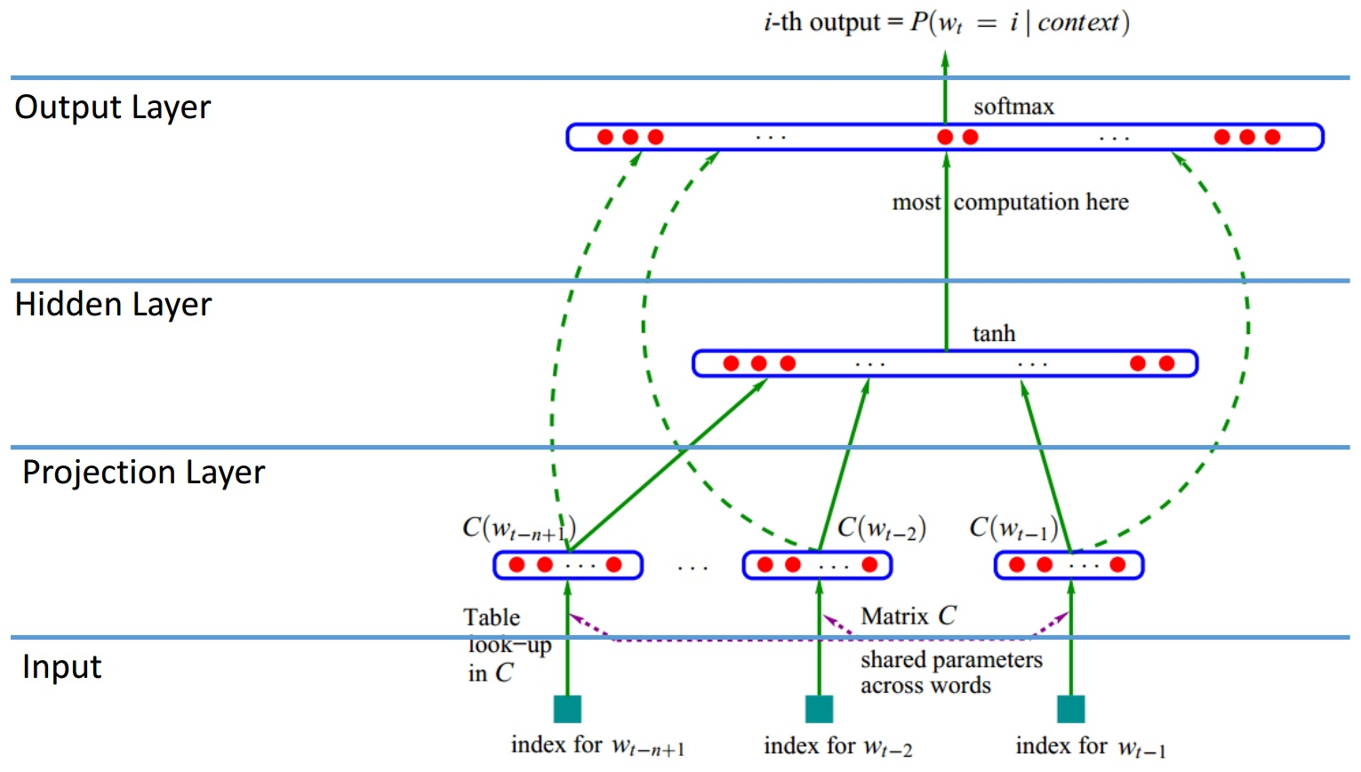
词向量的计算
2003年，Bengio在研究神经网络语言模型时同时训练词向量

Slide 8
Embeddings without LM: word2vec
Word2vec [by Tomas Mikolov/Google] can learn the word vectors via two distinct learning tasks,
  Continuous Bag-of-Words (CBOW)
  Skip-gram

Slide 9
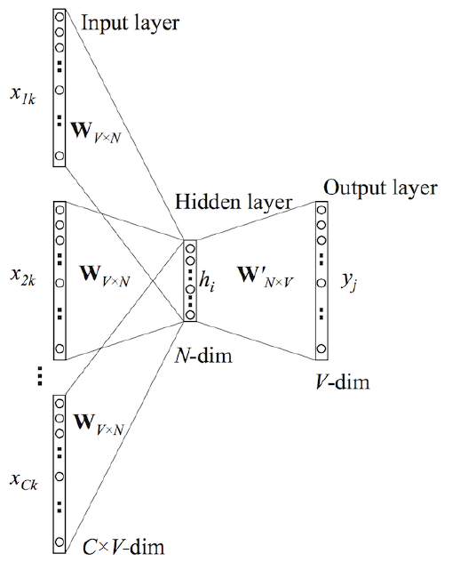
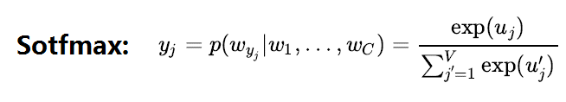


CBOW
predict the current word given only words in its Context C

Slide 10
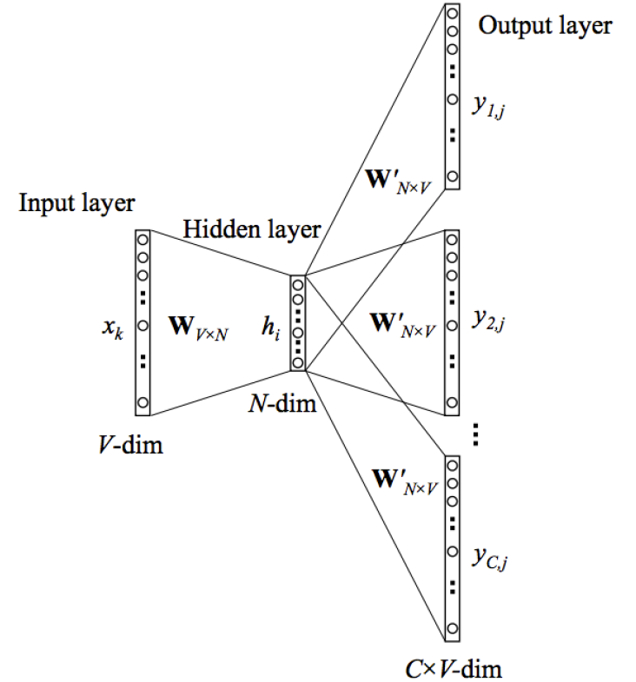
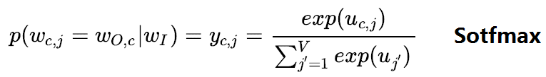

Skip-gram
predict words from Context C given a word

Slide 11
features
The Softmax in CBOW or SkipGram is time-consuming to compute, so it is often optimized using two methods
  Hierarchical Softmax
  Negative Sampling
Frequent words are also down-sampled
Skip-gram produces better word vectors for infrequent words
CBOW is faster by a factor of window size – more appropriate for larger corpora

Slide 12
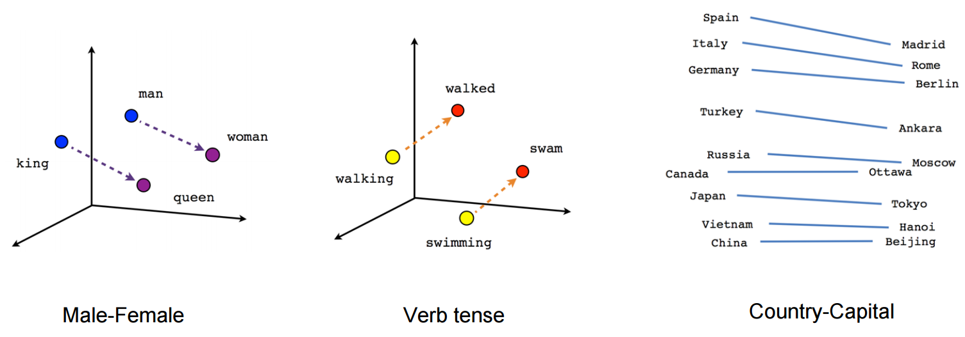
Power of Word Embeddings
vector[Queen] = vector[King] - vector[Man] + vector[Woman]

Slide 13
GloVe（Global Vectors）
GloVe does not rely just on local statistics (local context information of words) , but incorporates global statistics (word co-occurrence) to obtain word vectors.
  Word2vec: You shall know a word by the company it keeps — J.R. Firth
  GloVe: You can derive semantic relationships between words from the global/local co-occurrence matrix. (LSA)

Slide 14
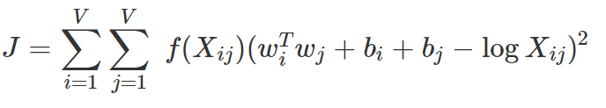



GloVe训练
优化目标函数
比Word2Vec性能更好

Slide 15
Problems of Embeddings learned by Word2Vec/GloVe
BOW model
One word embedding for each word: problematic for ambiguous words like type, bank
  Please type everything in lowercase.
  What type of flowers do you like most?
We need dynamic embeddings which change according to contexts instead of static embedding!

Slide 16
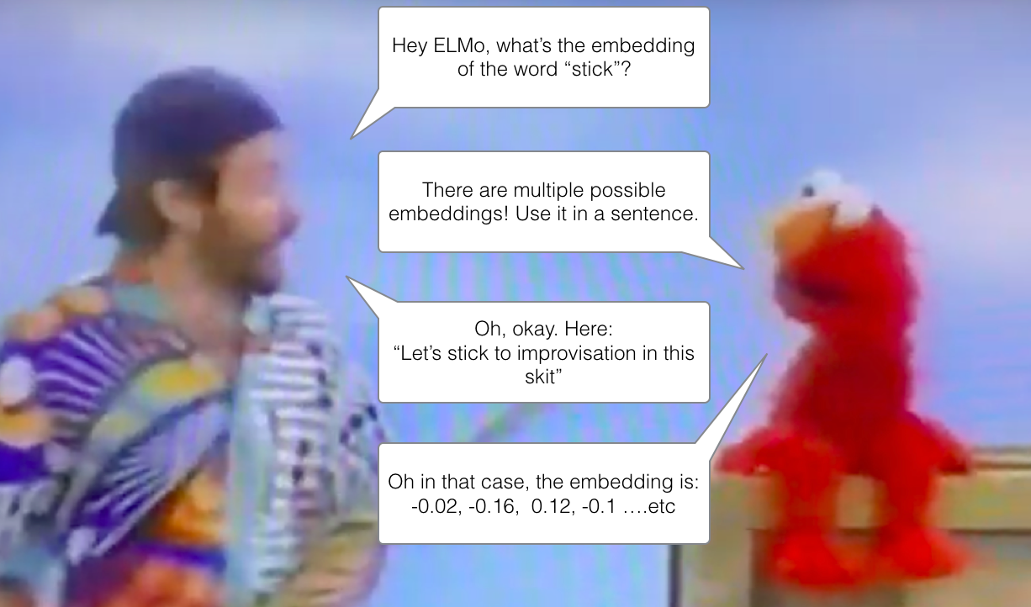
Elmo: Contextualized word-embeddings

Slide 17
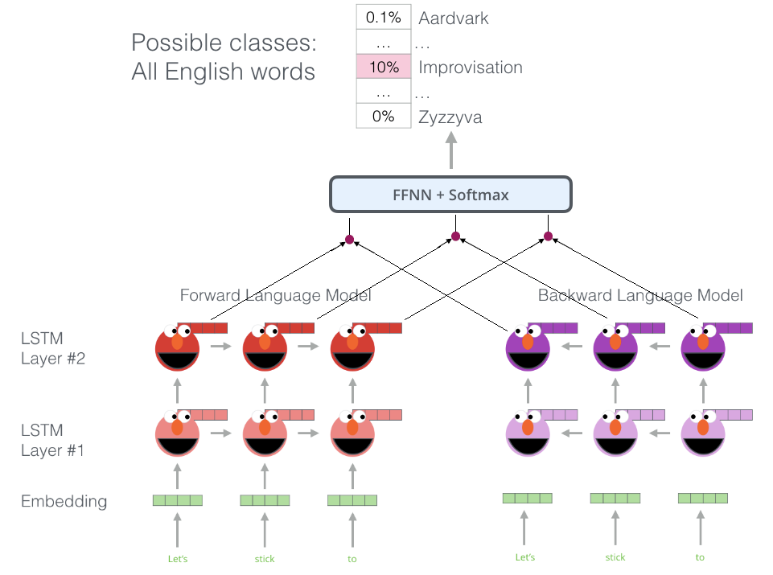
ELMO uses bidirectional-LSTM
FFNN: Feed-forward
Neural Network
ELMO can represent a word as a linear
combination of its hidden layers

Slide 18
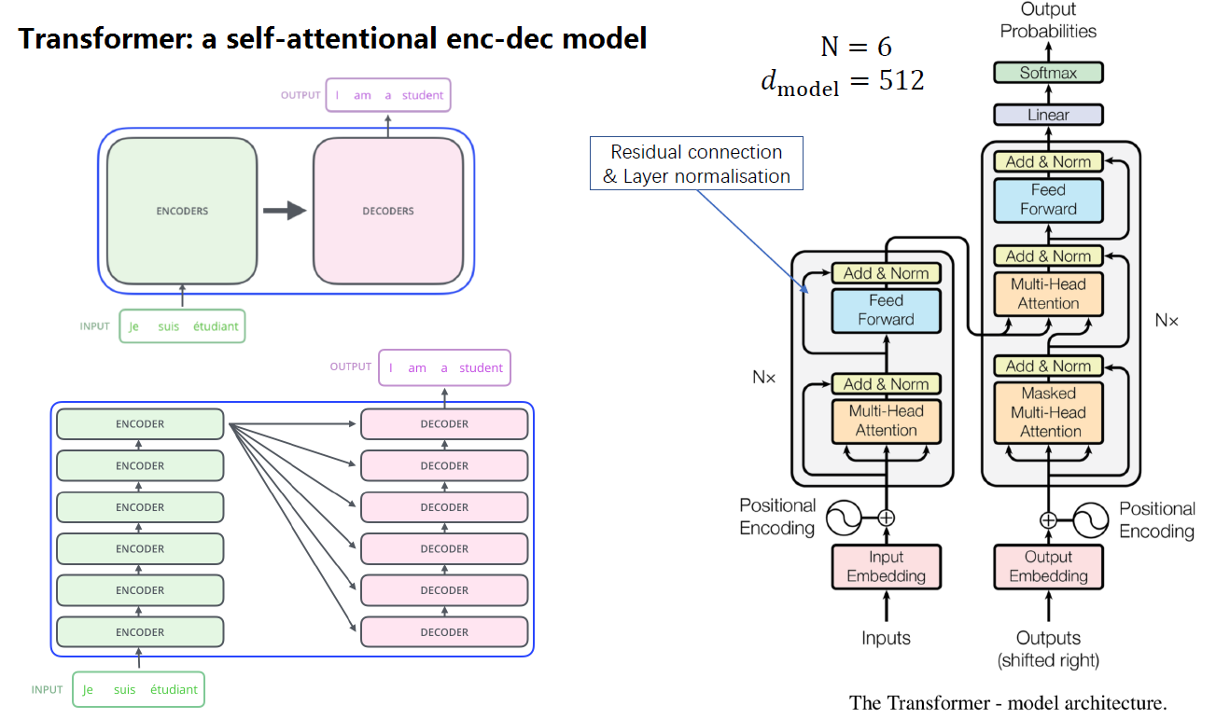

Slide 19
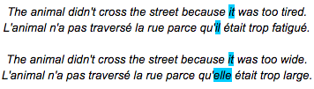
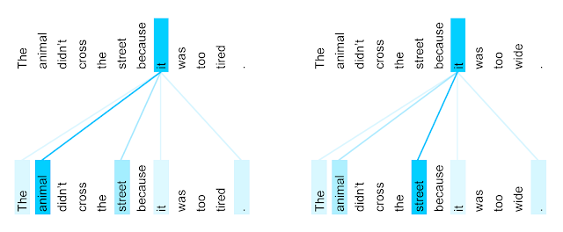
The power of self-attention
https://ai.googleblog.com/2017/08/transformer-novel-neural-network.html

Slide 20
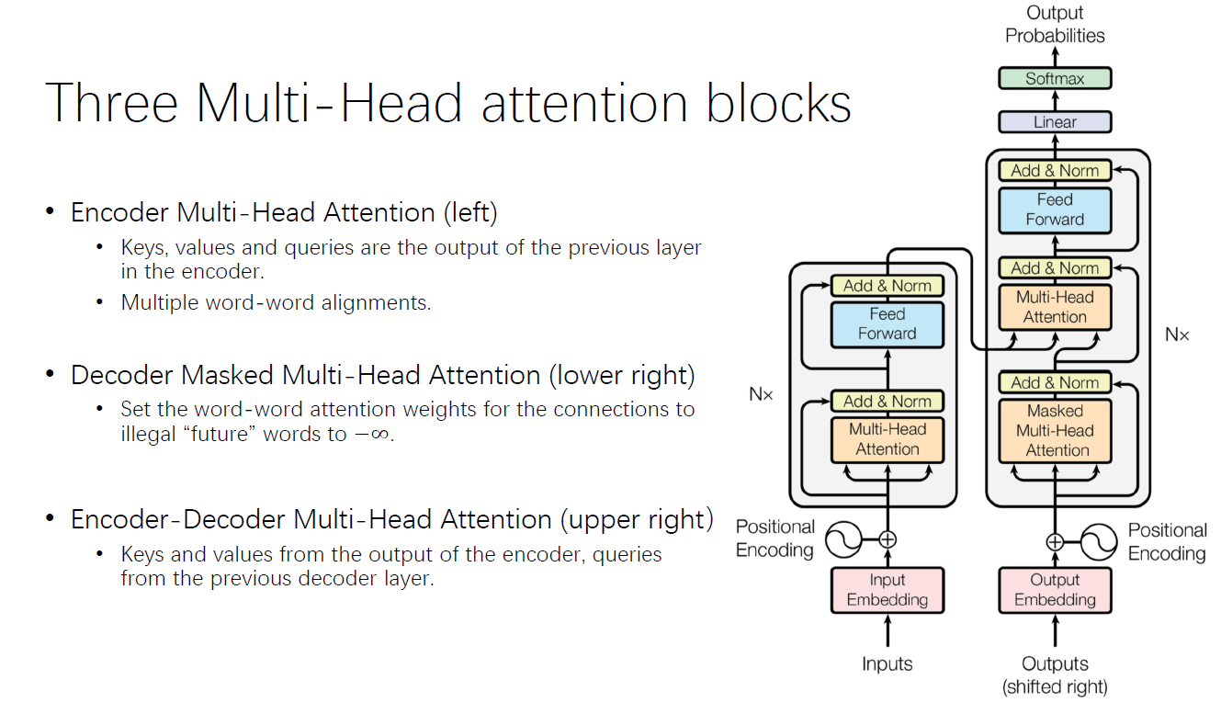

Slide 21
The Transformer: A replacement for LSTMs
The release of the Transformer paper (Vaswani et al 2017) and code, and the results it achieved on tasks such as machine translation started to make some in the field think of them as a replacement to LSTMs. This was compounded by the fact that Transformers deal with long-term dependencies better than LSTMs.

Slide 22
BERT
Like ELMo, it is bi-directional
Instead of LSTM, bert uses transformer-encoder
新东西：Masked Language Model（遮掉一些单词来进行其他单词的预测）
  其他辅助目标：下一句预测 (NSP)

Slide 23
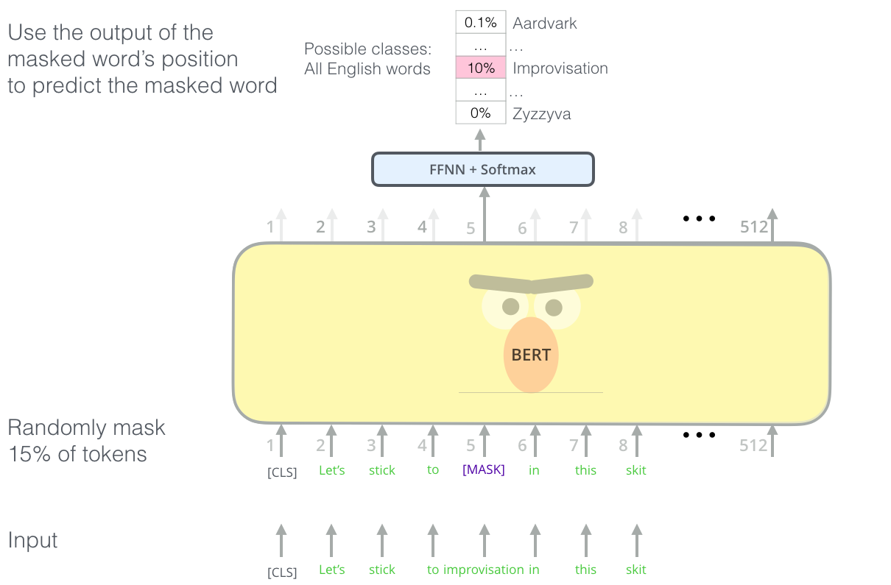

Slide 24
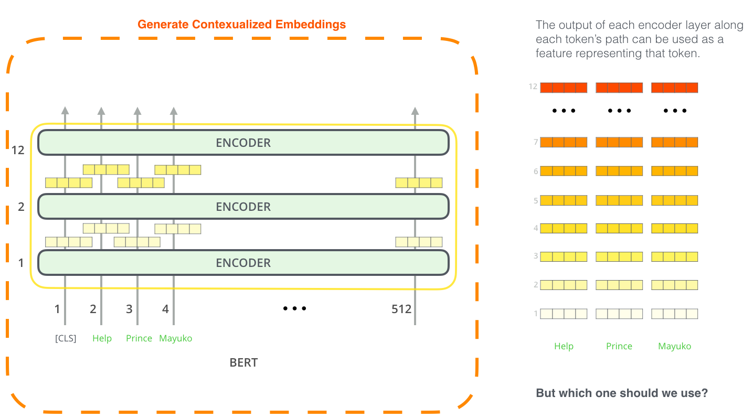
Pre-trained BERT can create contextualized word embeddings. Its powerful feature extraction can also be used for other tasks, e.g. named-entity recognition.

Slide 25
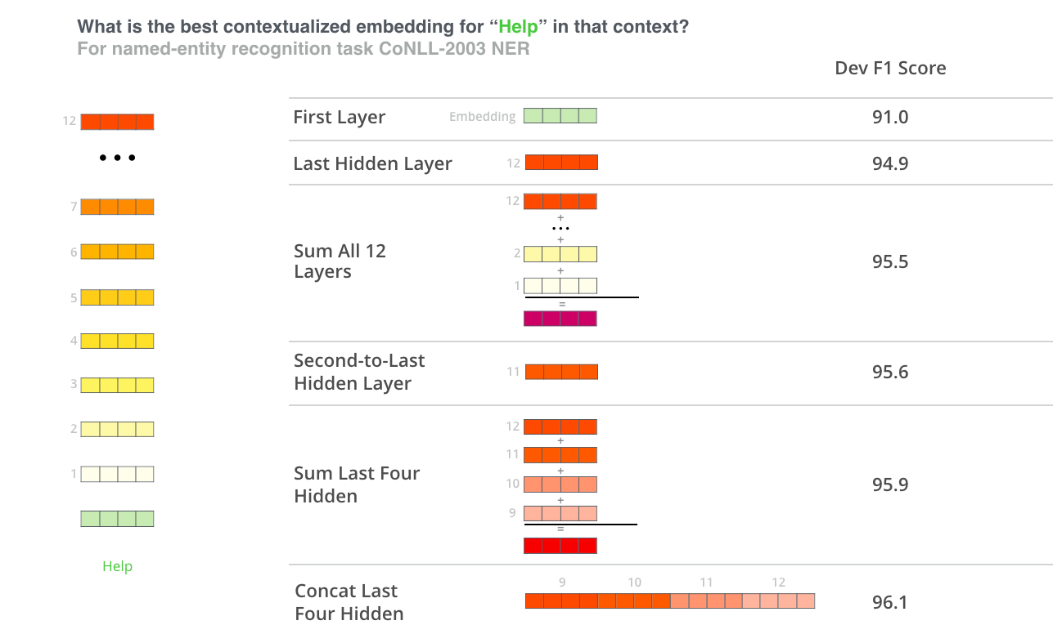

Slide 26
Bert一族
BERT
XLNet
RoBERTa
ALBERT
甚至Flaubert！

Slide 27
跨语言词向量(CLWE)
不同语言的词汇可以表示同样的概念。如sun和太阳指同样的东西。
但是如果你用英文语料库去训练英文词向量，用中文语料库去训练中文词向量，那这两个向量不是在同一个语义空间，那大概率是不同的。
如果所有的语言中的词汇，都在同一语义空间中表示为向量，那么机器翻译不是很容易了吗？
  Cross-lingual word embedding models are to MT what monolingual word embedding models are to language modeling.(by Sebastian Ruder)
引用自http://people.ds.cam.ac.uk/iv250/tutorial/xlingrep-tutorial.pdf，下同

Slide 28
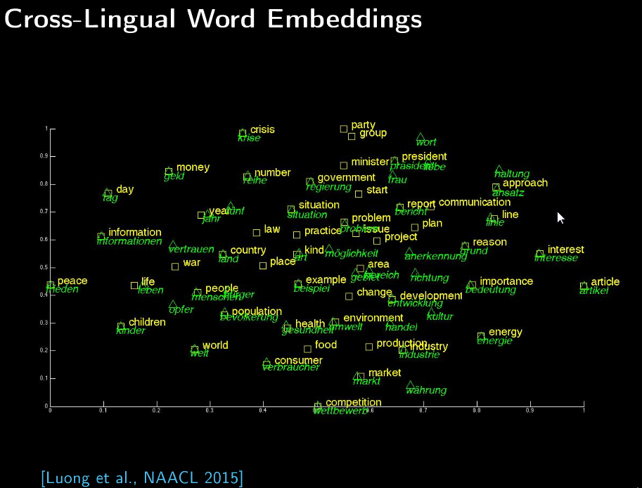

Slide 29

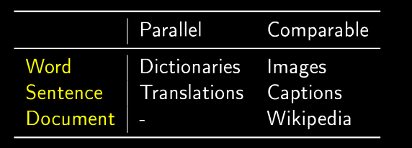
训练
All CLWE algorithms are doing roughly the same thing: a joint optimization over source language embedding, target language embedding, and cross lingual regularization:

Slide 30
跨模态语义向量
人们表达具体的对象，不但可以用语言，也可以用图片，声音等方式。
我们能否把图像与声音也表示成向量，而且最好在同一个语义空间中呢？
  当然，图片中有更小的对象，正如句子中有更小的单词

Slide 31
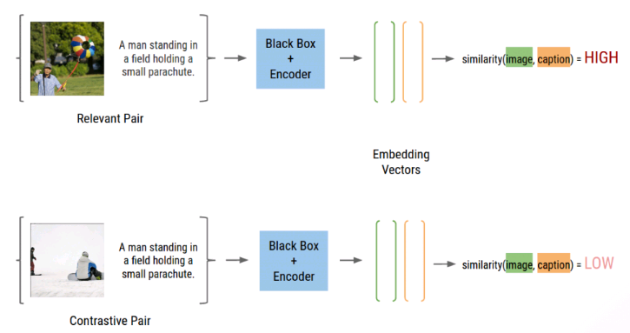
Image captioning
Use convolutional neural network for image representation and recurrent neural network for caption representation and a supervised captioning database to learning the relationship between the two embeddings.

Slide 32
Poincaré Embeddings
几何：
  欧氏几何，曲率为0，平行公理（1条平行线）
  双曲几何，曲率为负常数，罗巴切夫斯基几何，平行公理（多条平行线）
  椭圆几何，曲率为正常数，黎曼几何，平行公理（0条平行线）
动机：
  state-of-the-art embedding methods typically do not account for latent hierarchical structures which are characteristic for many complex symbolic datasets

Slide 33
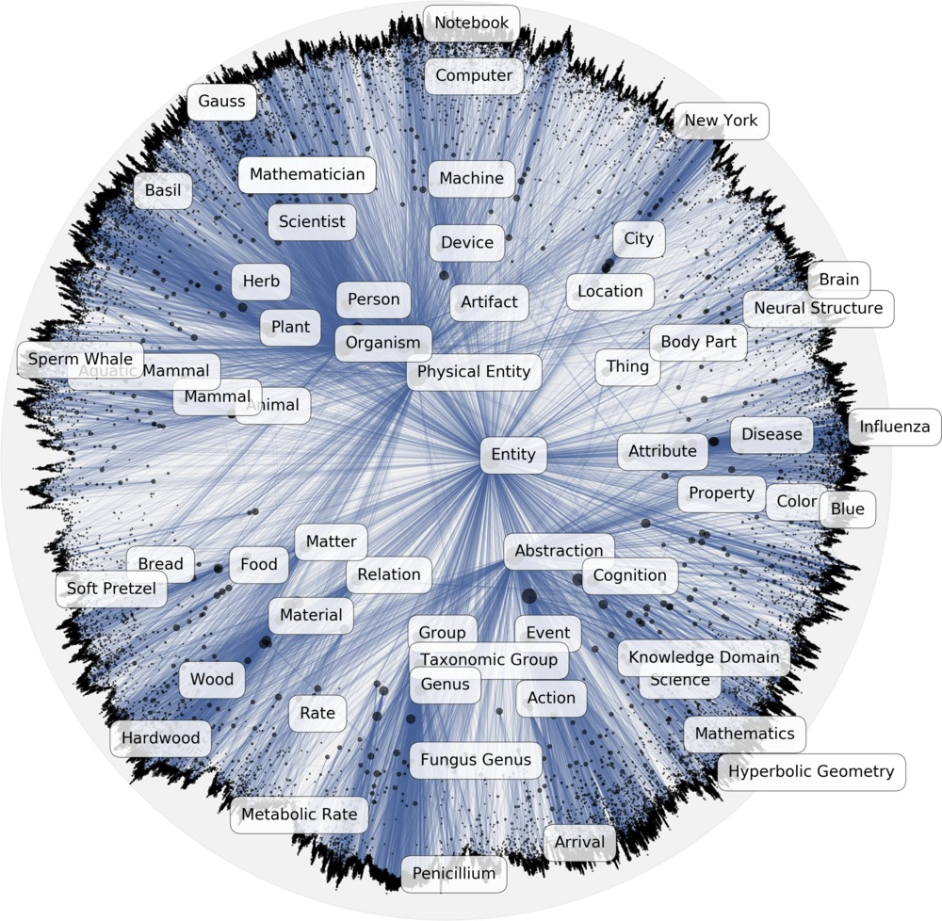
Poincaré Embeddings
在庞加莱圆盘模型（n维双曲几何模型）上建立embedding
https://research.fb.com/downloads/poincare-embeddings-for-learning-hierarchical-representations/

Slide 34
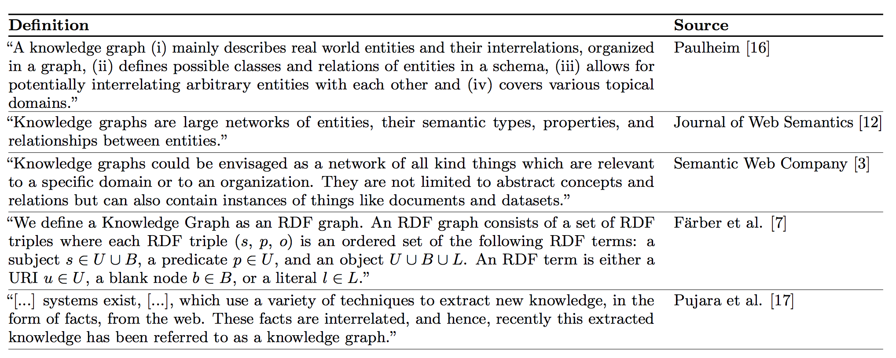
Knowledge Graph Embeddings

Slide 35
Knowledge Graph Embeddings
KG一般可看作是一个三元组的集合： (head, edge, tail)，其中head,tail是图中的结点（实体），edge是图中的边（关系）
在KG表示学习方面，有很多工作，其中TransE [Bordes et al., 2013] 比较有代表性，把实体和关系都映射为低维向量
  TransE assumes that in the vector space we have h + r ≃ t, which is simple and effective.

Slide 36

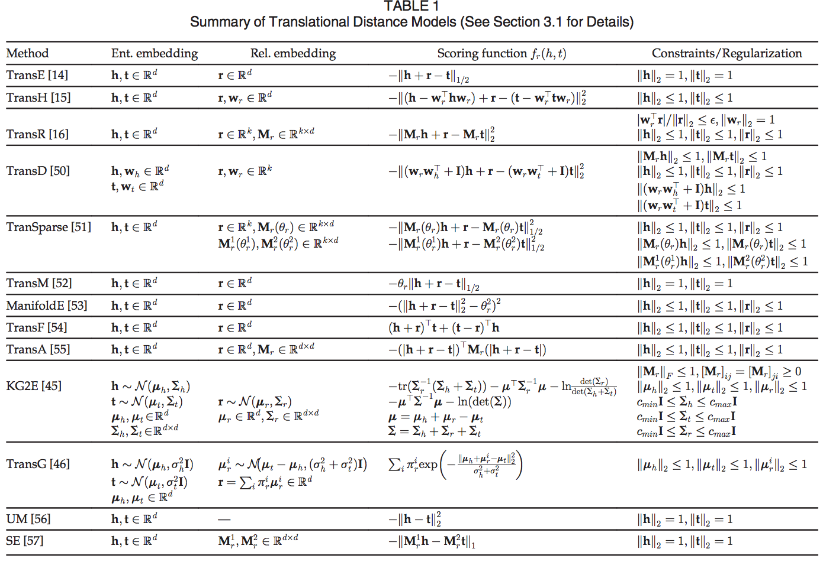
Knowledge Graph Embeddings
From Wang, 2017

Slide 37
Graph Embeddings
目标：represent a graph as low dimensional vectors while the graph structures are preserved.
这里的图比KG的图更广（后者一般是关系型知识）

Slide 38
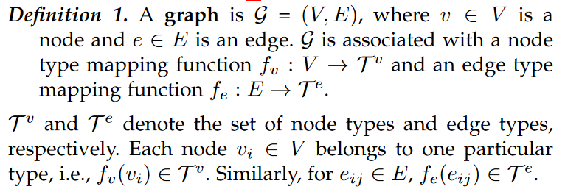
Graph Embeddings
Hongyun Cai et al. 2017. A Comprehensive Survey of Graph Embedding:
Problems, Techniques and Applications, 下文的几张ppt均来自本文

Slide 39
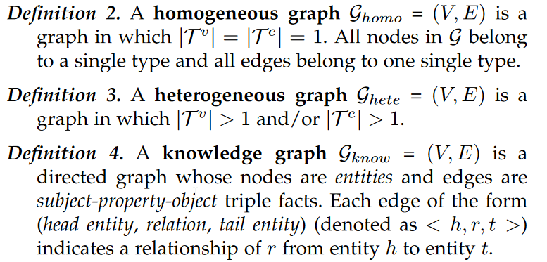
Graph Embeddings
knowledge graph can be viewed as an instance of the heterogeneous graph

Slide 40

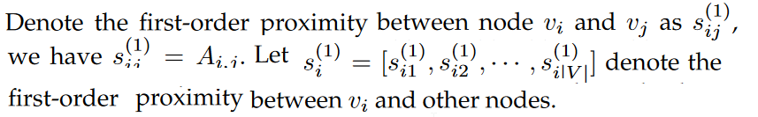
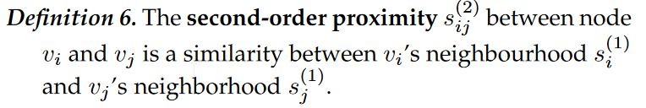
Graph Embeddings

Slide 41
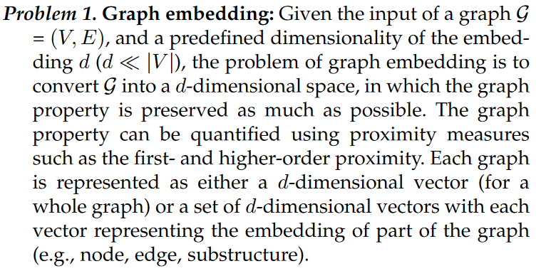
Graph Embeddings

Slide 42
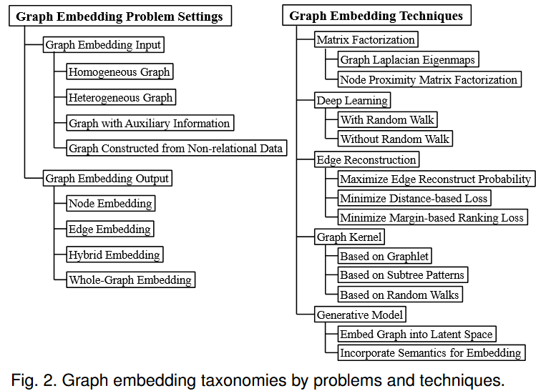
Graph Embeddings

Slide 43
Byte Pair Encoding
处理比词更小的单位：subword
  初始化：词分成字母/字符
  然后将最高频的相邻subword合并
然后对subword来计算Embedding

Slide 44
词向量的应用
词向量是所有现代NLP任务和应用的基础
  内部任务
  外部任务
  应用

Slide 45
单语词向量
内部任务
  语义相似度、同义词检测、词的类比、词典推导……
外部任务
  命名实体识别、语义角色标注……
应用
  问答系统、信息检索、文本生成

Slide 46
跨语言词向量
内部任务
  跨语言语义相似度、双语词典归纳、多模态表示……
外部任务
  机器翻译……
应用
  跨语言检索、问答……

Slide 47
一些有用的工具
谷歌的word2vec: https://code.google.com/archive/p/word2vec/
  在python中使用word2vec可以通过gensim模块
https://github.com/stanfordnlp/GloVe
https://github.com/google-research/ALBERT

Slide 48
作业
下载word2vec. 训练词的向量表示，并计算一个词的相似词和相关词。
（阅读）用词向量来做文本分类：http://nadbordrozd.github.io/blog/2016/05/20/text-classification-with-word2vec/

